Slide 1

Lets Look at
UASG / IDN / EAI
Presented by:
Dr. Ajay Data
Co-Chair – ICANN-NBGP
Expert Panel – Root Zone LGR Application
Coordinator – EAI – UASG.TECH
Member – ISPCP Constituency
Council Member – ICANN ccNSO (Oct 25th)
https://www.xgenplus.com

Slide 2
Warm-up Exercise
According to w3techs, which of the following pie charts most closely represents the fraction of websites on the Internet that are primarily English language based content?
25% English
75% All other
50% English
50% All other
75% English
25% All other
Actual data can be found at https://w3techs.com/technologies/history_overview/content_language/ms/y. Data shown is approximate.

Slide 3
Warm-up Exercise: Solution
According to w3techs, which of the following pie charts most closely represents the fraction of websites on the Internet that are primarily English language based content?
25% English
75% All other
50% English
50% All other
75% English
25% All other
Actual data can be found at https://w3techs.com/technologies/history_overview/content_language/ms/y. Data shown is approximate.
Notes:
The pivot from English-dominant to Other Language-dominant content is an symbolic moment in the history of the Internet, and will occur in the next couple of years.

Slide 4
Warm-up Exercise
Send Email – Lets see if you can
To : uasg.tech@डाटामेल.भारत
Cc: ajay@xgenplus.com
Cc: अजय@डाटा.भारत

Slide 5
Exercise for later
Install DataMail App
Get a linguistic ID for yourself
Send email from new linguistic ID to your own email address
Do you get it perfectly ?

Slide 6
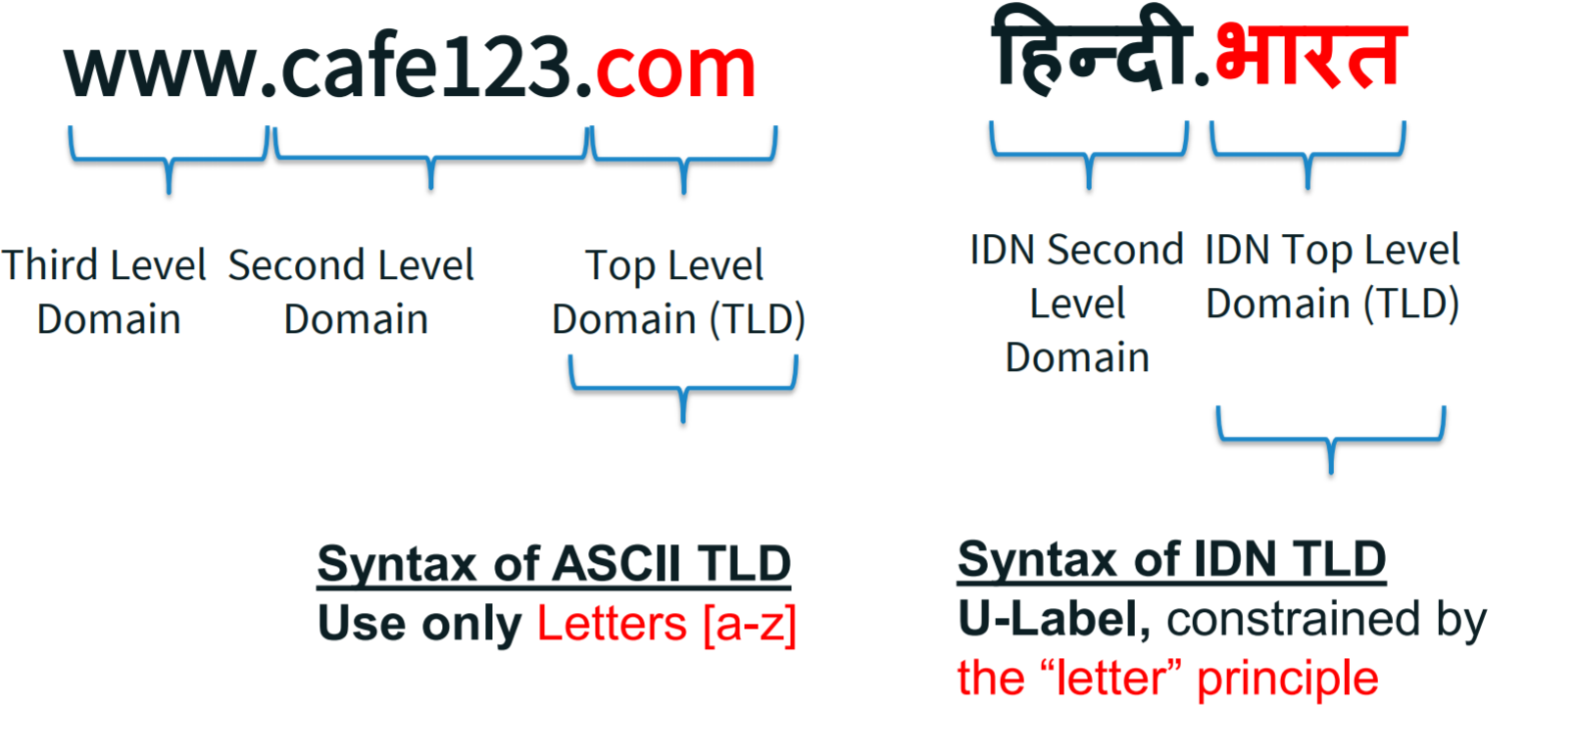
Understanding Domains

Slide 7
Internationalized Domain Name
Brief IDN History
Since last 17 years – work on IDNs is going on .
First IDNs were made available in 2010
India adopted IDNs in 2014
भारत

Slide 8
Government of India – Visionary Steps taken
१) भारत, २) कंपनी.भारत, ३) विद्या.भारत, ४)सरकार.भारत
Internationalized Domain Name (IDN) | Language
.भारत | .Bharat in Devanagari
.ভারত | .Bharat in Bengali
.భారత్ | .Bharat in Telugu
.ભારત | .Bharat in Gujarati
. بھارت | .Bharat in Urdu
.இந்தியா | .Bharat in Tamil
.ਭਾਰਤ | .Bharat in Gurumukhi (Punjabi)

Slide 9
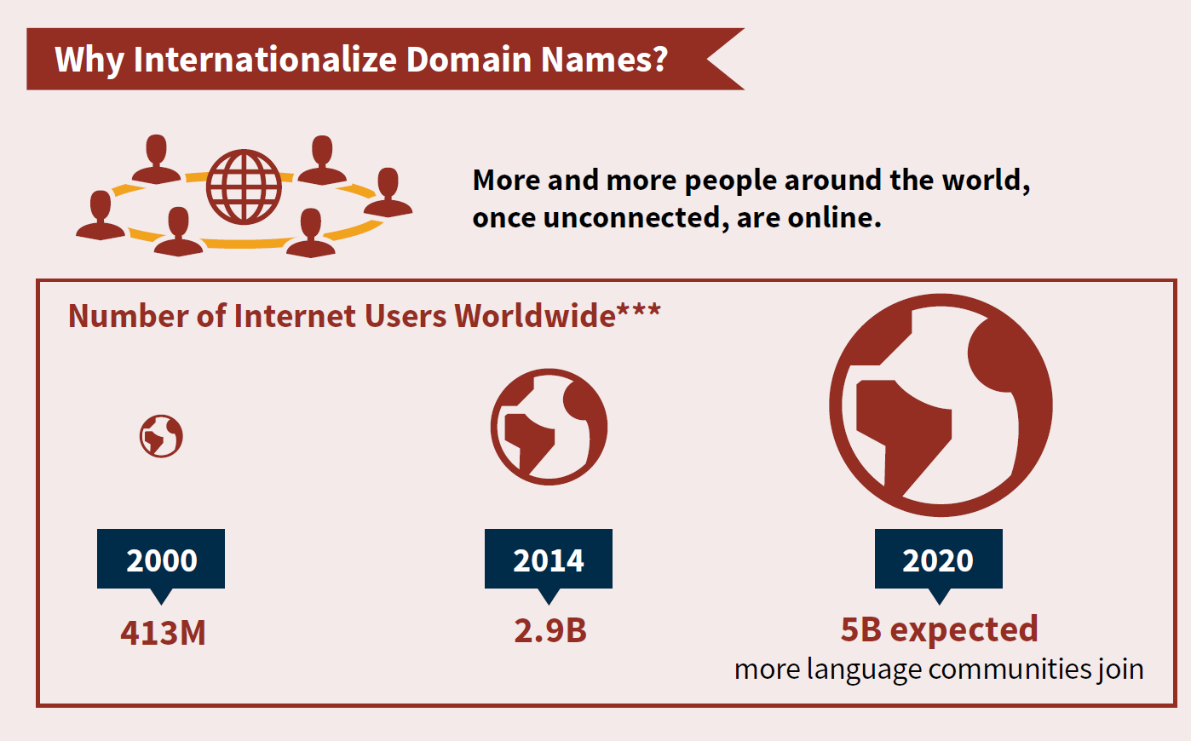
Opportunity
Source**: internetlivestats.com

Slide 10



EAI - Email Address in your language
अजय@डाटा.भारत (Hindi)
ਨਿਤਿਨ@ਦਾਤਾ.ਭਾਰਤ (Punjabi)
વૈશાલી@દાતા.ભારત (Gujrati)
மனிஷ்@ட்ட.பாரத (Tamil)
ప్రియాంక@డేటా.భారత్ (Telugu)
رضوان @ڈیٹا.بھارت (Urdu)
संपर्क@डेटामेल.भारत (Marathi)
র্যাম@ডাটামেল্.ভারত (Bengali)
And SO On………..
Languages of India

Slide 11
Lets look at भारत
Only 400 million people uses Internet
300 million are on mobile (mobile broadband nation)
22 official languages
Consumption of Regional content is more than English
Indian language internet users are growing @ 18% as against 3%.
ICANN / WEF / UNESCO :
Next billion people will come online if we can break language barrier

Slide 12
Lets look at भारत
3 regional language is now LAW in every mobile phone.
22 official languages is must in phone for reading the content in every phone from 1st May 2018.
All official website are in English+Regional language
To access regional language, person is still
supposed to know English ?

Slide 13
Lets look at भारत
Domain name with .भारत makes website 100% accessible
In users preferred language, without knowing English.
Language barrier broken

Slide 14
भारत – Biggest Opportunity
Next 500 million people can come online
if we break the language barrier.
Similar companies like
Amazon, Paypal, Facebook, Twitter, Google
Can be from India in regional language.

Slide 15
Understanding
Universal Acceptance

Slide 16





Five Criteria of UA
Accept
Validate
Store
Process
Display
Universal Acceptance is the state where
all valid domain names and email addresses are accepted, validated, stored, processed and displayed correctly and consistently
by all Internet-enabled applications, devices and systems.

Slide 17
Prepare to do business and communicate with a global user base
Continued expansion of the Internet is allowing access to an increasingly diverse user group
There is a growing number of languages and scripts present on the Internet, including non-Latin based, language-specific domain names in Arabic, Chinese and many other scripts.
It is required that your Internet-enabled applications, devices and systems accept, validate, store, process and display all domain names and email address appropriately.
Notes:
Motivation slide.
Students should understand what is expected of them with regard to UA and EAI.

Slide 18
What we need to do ?
break the cost and language barrier
Freedom for Idea, adoption, innovation, execution and
serve the un-served भारत.

Slide 19
Lets Discuss - Questions
@ajaydata on Twitter
ajay@xgenplus.com on email
अजय@डाटा.भारत - EAI
www.ajaydata.com on web
Or simply
Google “ajay data”

