Slide 1
Blockchain for Social Good
Glenn McKnight

Slide 2
What is blockchain? How can the blockchain leger help the most vulnerable the world?

Slide 3
Blockchain Blockchain can be thought of as an incorruptible ledger that stores transactions which are replicated across multiple computers on a decentralized network (this could be hundreds, thousands or even millions of computers).
Each computer plays a role in making the ledger tamper-proof, thus increasing the strength of the network. This digital ledger maintains security and traceability, while cutting out unnecessary intermediaries.

Slide 4
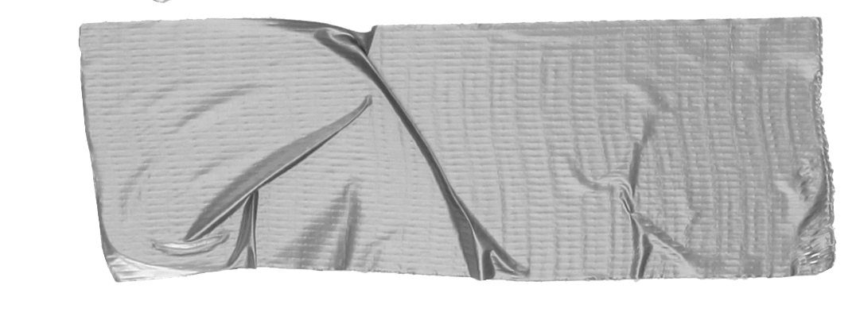
Objective of presentation
Expectations Manage realistic expectations of the technology
Case Studies Provide some best practices using Blockchain for Social Good
Next Steps Provide a simple unifying message to encourage more development

Slide 5
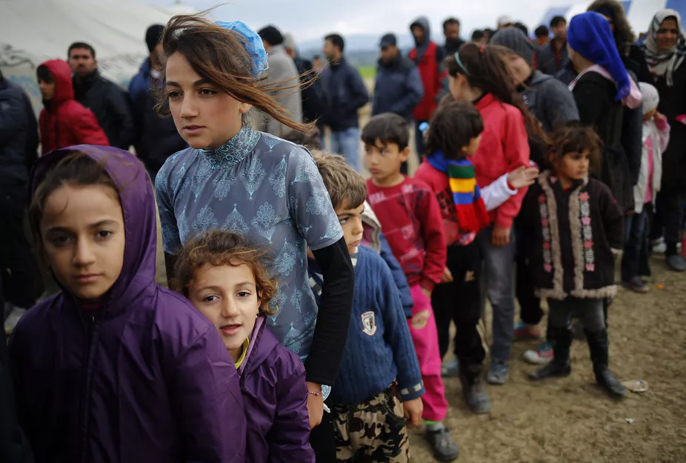
Humanitarian Challenge
According to the UNHCR, as of today, there are over 68 million people displaced, over 25 million of whom are refugees
Ensuring refugees access to critical services is key. But how can accessibility be improved for healthcare, education and financing? They lack legal identity results in millions of refugees being denied or delayed from accessing services
Solution:, leveraging blockchain technology to deliver digital identities can deliver the much-needed solution to the refugee identification crisis.

Slide 6
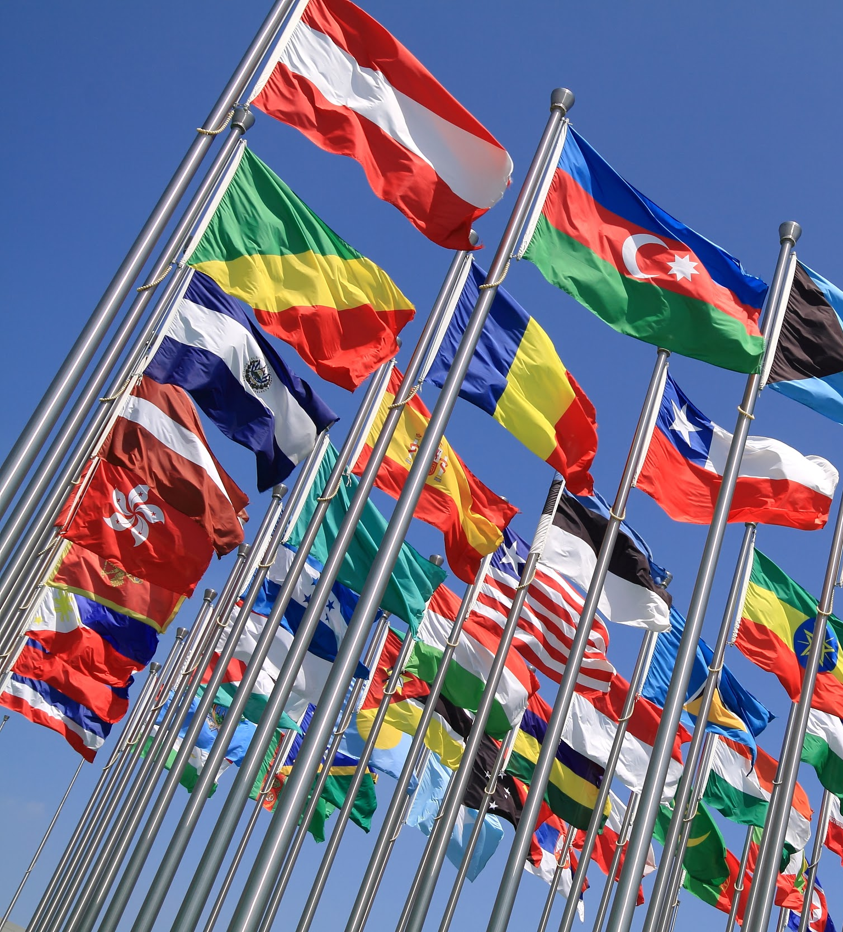
Organisations working hard to improve the lives of refugees can utilise blockchain-enabled digital identity solutions as a means of understanding how resources are distributed, as well as to cut down on identity fraud and data mismanagement, while allowing organisations to reduce their burden around costs and resources.

Slide 7
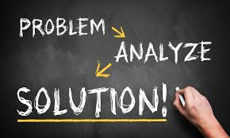
Digital identities function as the basis for refugees accessing entitlements such as aid, welfare, remittances, donations, and healthcare.
With every activity immutably recorded, a blockchain solution provides transparency and traceability to the process of recordkeeping. As data builds on the blockchain, information accumulates and the technology effectively provides a de facto foundation where information can be structured, reviewed and utilised.
When refugees use their digital identity to receive aid and support, they are also capturing data of their activities — building a social and economic history.

Slide 8
Life Changing
With a permanent, cross-border identity record, blockchain can be used for work permits and asylum application processing. The technology could also greatly increase a refugee’s ability to work and give them the ability to legally access basic services, including banking, healthcare and welfare.
Transformative
Many positive stories can be told of people starting their lives again

Slide 9
Benefits
Blockchain ensures a refugee’s identity is not stolen, forged or duplicated by hosting their personal information on a decentralized ecosystem. Stored on “blocks” that are continuously verified and secured through cryptography, blockchain is critical in protecting a refugee’s data from being exploited. The documentation of these refugees could make a huge difference to their lives especially as it might alter the public’s perception of them.

Slide 10
Blockchain
Blockchain has the capacity to affect significant, positive change for the future of refugees and humanity. Blockchain will not only emerge as the integral infrastructure capable of revolutionising assistance during a refugee crisis, but also as the mechanism that has the potential to eradicate it.

Slide 11
Case Study 2
Services to the Unbanked

Slide 12
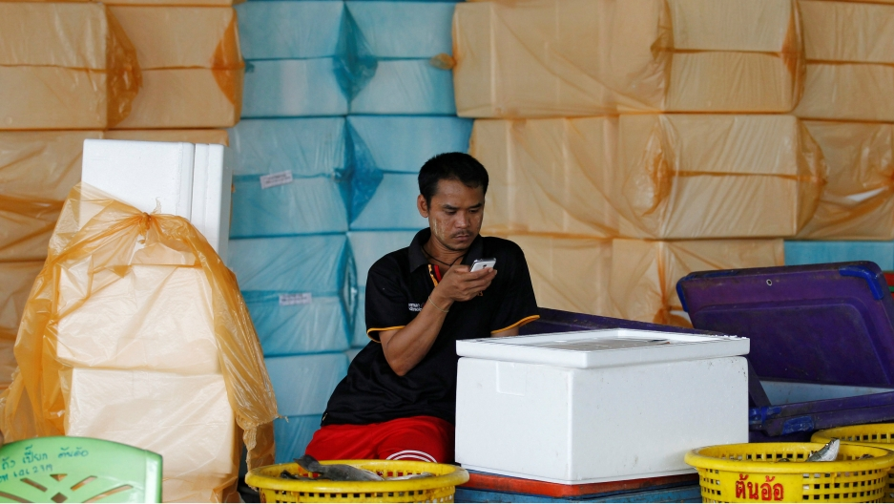
Banking for the Unbanked
More than 70 percent of Southeast Asia’s 600 million people are “unbanked,” so to speak, because they lack capital, documents or status. Millions struggle under this status quo.
A migrant worker from Myanmar looks at his cellphone at a wholesale market for shrimp

Slide 13
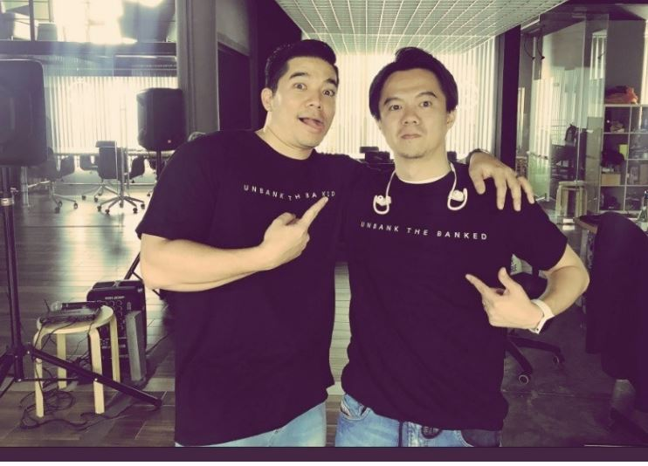
Hundreds of millions of people in Southeast Asia don't have bank accounts because they lack capital, documents or status. But many of these same people have cellphones, and a new early stage startup called OmiseGO hopes blockchain technology can give them access to digital cash.
OmiseGO founders Jun Hasegawa and Ezra “Don” Harinsut at their headquarters in Bangkok, Thailand

Slide 14
Like Facebook and Google before them, blockchain evangelists say they’re poised to transform societies in short order.
The difference
They are focused on the hundreds of millions of hard-laboring people who don’t even have bank accounts.
Think taxi drivers in Manila, noodle sellers in Indonesia or migrants from Myanmar. The startup calls them “the unbanked.”

Slide 15
Vansa Chatikavanij, OmiseGO’s managing director
“having the ability to transact
money easily should be seen as a human right.”

Slide 16
Reality..... farmers, merchants, migrants and factory hands — are now quite likely to own smartphones
This allows for financial tech projects to “radically shift the economic foundation of the region” and become a “lynchpin for more than just economic change, but for true social change.”

Slide 17
Key Features
Low transaction fee
Secure and trusted transactions
Major disruptive technology to the banking industry
Lots of challenges to overcome
No transactions yet

Slide 18
Resources
A tech startup called OMG wants to revolutionize cash for hundreds of millions of 'unbanked' people in Asia https://www.pri.org/stories/2018-07-19/tech-startup-called-omg-wants-revolutionize-cash-hundreds-millions-unbanked

