Slide 1
ICT Standards
Anupam Agrawal
Chair
Internet Society Kolkata Chapter

Slide 2
What is happening in India today?
ISO – BIS - Secretariat in India of SC 7 – Software & Systems Engineering
Blockchain - TC 307 – First Participation
Futurewatch Panel
TSDSI – Telecom Standards – One M2M
IICB – Indian IETF Capacity Building Program & IIESOC
IEEE Chapters increased involvement
INCOSE & Other Liaison Organizations including ICANN

Slide 3
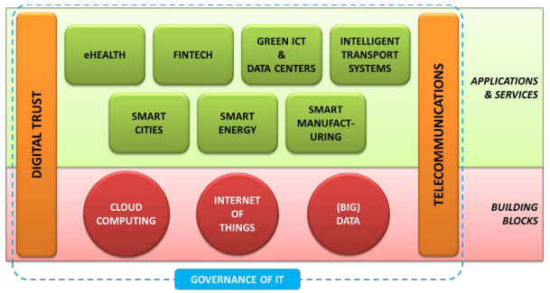
The Context Today
The Landscape
The Thirteen Subsectors of ICT driving the demand
Source “ ITU Annual Report

Slide 4
New Age Business
CONTINUOUS EVOLUTION OF TECHNOLOGY
Many new technologies emerging
Technologies are made much more effective due to the high quality connectivity enabled by the Internet of today
Enabling ecosystems exist and this facilitates very rapid technology adoption
Obsolescence of people, process and technology can happen very fast
VALUE DELIVERY DEPENDENT ON MATURE YET EVOLVING ECOSYSTEMS
API-fication of enterprise platforms
A complex ecosystem of entities involved in the value-delivery chain
Systems rarely isolated – usually part of a system of systems
Value delivery is based on collaboration of several entities
Collaborators can sometimes be competitors .
EMERGENCE AND DOMINANCE OF PLATFORMS
Big Platforms have emerged with subscriber bases larger than many nations
Platforms are making decisions based on learning algorithms
Learning algorithms are “sucking out the IP” of users
Interoperability of platforms is becoming a serious issue.
Codify platform ethics and to require an explain capability for machine made decisions
ESSENTIALLY INTERNATIONAL CHARACTER
Technology enables a global market
Each supplier has a global ambition
Each consumer has a global choice
National and Regional tensions on issues like privacy, consumer protection, taxation and sovereignty
The technology and its underpinning are globally interoperable
The legal and social systems in various countries and regions are not

Slide 5
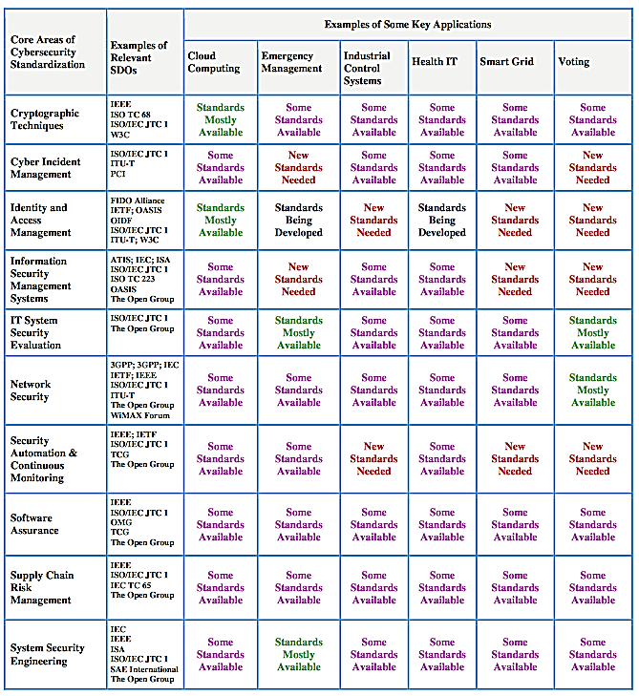
New Standards Needed
- Emergency Management
Cyber Incident
Information Security Management
- Industrial Control Systems
Identity & Access Management
Security Automation & Continuous Monitoring
Smart Grid
Identity & Access Management
Information Security Management
Security Automation & Continuous Monitoring
Voting
Cyber Incident Management
Identity & Access Management
Information Security Management
Security Automation & Continuous Monitoring
Source : NIST Archives

Slide 6
internet standards
- terms of engagement of key bodies
 | IETF | OASIS | OMG | W3C | ISO
Entrance Barrier | Low – Zero USD 0 | Low- High USD 250 – 40K | Medium – High USD 500- 70K | Medium – High USD 635 – 63.5K/ Invitation | Low – Member of National Body
WG formation | BOF + Charter. Approval required | 3 members / max cycle 30 days | Ad-hoc | Restricted to current W3C activities | NWIP
Procedure Rules | Strict | Formal | Strict | Strict | Very Strict
IP Rules | RAND | RAND | RAND | W3C License | SEP & RAND
Conceptual Framework | Areas | None | MDA | WS Architecture | Technology
Implementation Required | Yes | No | Yes, Not enforced | Yes | Not

Slide 7
Rationale for Participation – Standards
Contribute to the growth of the body of knowledge
Spot new opportunities fast
Position correctly in developing Ecosystems

Slide 8
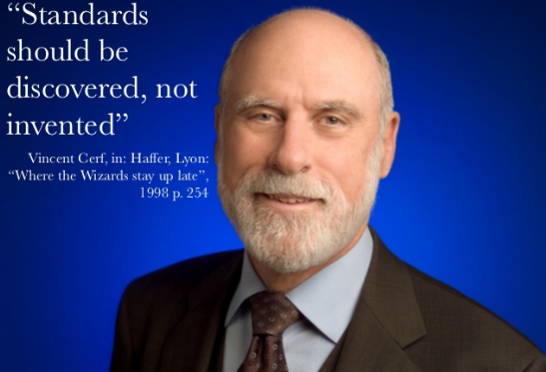
The father of internet says

Slide 9
Thanks!!!

