Slide 1
Universal Acceptance
हरीश चौधरी (HARISH CHOWDHARY) harish@nixi.in

Slide 2
Warm-up Exercise
According to w3techs, which of the following pie charts most closely represents the fraction of websites on the Internet that are primarily English language based content?
25% English
75% All other
50% English
50% All other
75% English
25% All other
Actual data can be found at https://w3techs.com/technologies/history_overview/content_language/ms/y. Data shown is approximate.

Slide 3
Warm-up Exercise: Solution
According to w3techs, which of the following pie charts most closely represents the fraction of websites on the Internet that are primarily English language based content?
25% English
75% All other
50% English
50% All other
75% English
25% All other
Actual data can be found at https://w3techs.com/technologies/history_overview/content_language/ms/y. Data shown is approximate.
Notes:
The pivot from English-dominant to Other Language-dominant content is an symbolic moment in the history of the Internet, and will occur in the next couple of years.

Slide 4
Prepare to do business and communicate with a global user base
Continued expansion of the Internet is allowing access to an increasingly diverse user group
There is a growing number of languages and scripts present on the Internet, including non-Latin based, language-specific domain names in Arabic, Chinese,Denanagari and many other scripts.
It is required that your Internet-enabled applications, devices and systems accept, validate, store, process and display all domain names and email address appropriately.
Notes:
Motivation slide.
Students should understand what is expected of them with regard to UA and EAI.

Slide 5
Goals for Today’s
1
Understand and be able to describe the 5 criteria of Universal Acceptance
2
IDNs and Email Address Internationalization
3
Multilingualism on Internet : Current Trends

Slide 6





Five Criteria of UA
Accept
Validate
Store
Process
Display
Universal Acceptance is the state where
all valid domain names and email addresses are accepted, validated, stored, processed and displayed correctly and consistently by all Internet-enabled applications, devices and systems.
Current Trends

Slide 7

Accept
Key points:
Applications and services allow domain names and email addresses to be:
  Entered into user interfaces, AND/OR
  Received from other applications and services via APIs.
Accepting occurs whenever an email address or a domain name is received as a string of characters from a user interface, from a file, or from an API used by a software application or online service.
Notes:
UASG Recommendations
User interface elements requiring user to type domain name/email address must support Unicode and strings up to 256 characters
Users should be allowed to enter ASCII Compatible Encoded text (“Punycoded”) in place of Unicode equivalent
Unicode should be shown by default
Punycoded text should only be shown when provides a benefit

Slide 8

Validate
Key Points
  Intended to ensure that the entered information is either valid or at least definitely not invalid
  For domain names and email addresses, many programmers have been using heuristics (for example, checking that a TLD has the “correct” number of characters, or that the characters are from the ASCII character set). These heuristics are no longer applicable because the Internet is changing:
    Domain names and email addresses can now include Unicode characters (and punycode strings)
    The list of TLDs is growing, changing, and includes left-to-right scripts
    A TLD can be up to 63 characters long
Validation may occur in many places whenever an email address or a domain name is either received or emitted as a string of characters by an application or online service.

Slide 9

Store
Key Points
  Applications and services might require long-term and/or transient storage of domain names and email addresses. Regardless of the lifetime of the data, it must be stored in:
    RFC-defined formats, OR
    Alternate formats that can be easily translated to and from RFC-defined formats (this is much less desirable)
  Although RFCs require the use of UTF-8 (see RFC 5890), other formats may be encountered in legacy code. See the “Good Practices” section.
The Storage process occurs whenever an email address or a domain name is stored as a string of characters in a database or file used by a software application or online service.
Notes:
Discussion Point: Instances where email addresses and domain names have been filed under the “author” field of a document or “contact info” in a log file have led to the loss of origin as an address.

Slide 10

Process
Key Points
  Processing means using domain names and email strings in a feature. Additional validation may occur during processing. There is no limit to the number of ways that domain names and email addresses could be processed.
  Examples:
    “Identify all the people associated with New Zealand because they have a name with a .nz ccTLD”;
    “Identify all the pharmacists because they have a user@example.pharmacy email address”;
    “Identify firewalls that might filter DNS requests that don’t apply to their policies”.
Processing occurs whenever an email address or a domain name is used by an application or service to perform an activity (for example, searching or sorting a list), or transformed into an alternate format (such as storing ASCII as Unicode).
Notes:
Activity (e.g., searching or sorting a list)
Alternate format (e.g., storing ASCII as Unicode).
Additional validation may also occur during processing.
Domain names and email addresses can be processed in an unlimited number of ways*, which reinforces the need for conventions that ensure data is being understood and classified consistently.

Slide 11

Display
Key Point
  Displaying domain names and email addresses is usually straightforward when the scripts used are supported in the underlying operating system and when the strings are stored in Unicode. If these conditions are not met, application-specific transformations may be required. Organizations may also have their own display criteria.
The display process occurs whenever an email address or a domain name is rendered within a user interface.

Slide 12
Summary
Accept
Validate
Store
Process
Display
It is required that your Internet-enabled applications, devices and systems accept, validate, store, process and display all domain names and email address appropriately.

Slide 13


IDNs & E-mail Address I18N

Slide 14
What are Internationalized Domain Names
Domain Names in Local Languages
Example:
http://सिनेमा.भारत/
http://निक्सी.भारत/
Notes:
Motivation slide.
Students should understand what is expected of them with regard to UA and EAI.

Slide 15
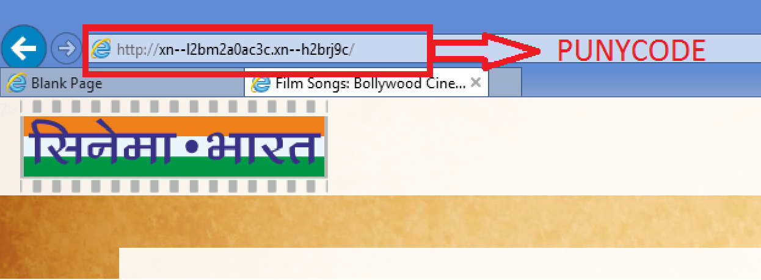
IDNs : What is Punycode
Source : qz.com
Notes:
Motivation slide.
Students should understand what is expected of them with regard to UA and EAI.

Slide 16

Email Address I18N : E-mail Flow
A typical e-mail message is
1. Generated using proprietary software (i.e. Gmail, Rediff Mail, Yahoo Mail etc.)
2. Using an open source library
3. Transmitted using a mixture of SaaS vendors and open source
4. Received/handled using an open source library
5. That's being used by proprietary software
There are around 100 components do most of steps from 2-4, mostly open source.
Notes:
Motivation slide.
Students should understand what is expected of them with regard to UA and EAI.

Slide 17
SMTP: E-mail Message Transmission
Most Internet email seems to be delivered by one of four MTAs
Postfix: 50% (of the world excluding Gmail/Microsoft Exchange)
Exim: 30%
Sendmail and Qmail: 10%
Many others: the rest (zmailer,smail3 etc.)
Notes:
Motivation slide.
Students should understand what is expected of them with regard to UA and EAI.

Slide 18
Inference
It shows that modifying/patching a small number of libraries, toolkits, frameworks eventually has a very big effect on deployment and acceptance of Internationalized e-mails.
Patch -
SMTPUTF8(RFC 6530)
Existing MTA’s
SMTPUTF8 enabled MTA’s
These changes include an SMTP extension and extension of email header syntax to accommodate UTF-8 data to enable EAI in readable format
Notes:
Motivation slide.
Students should understand what is expected of them with regard to UA and EAI.

Slide 19
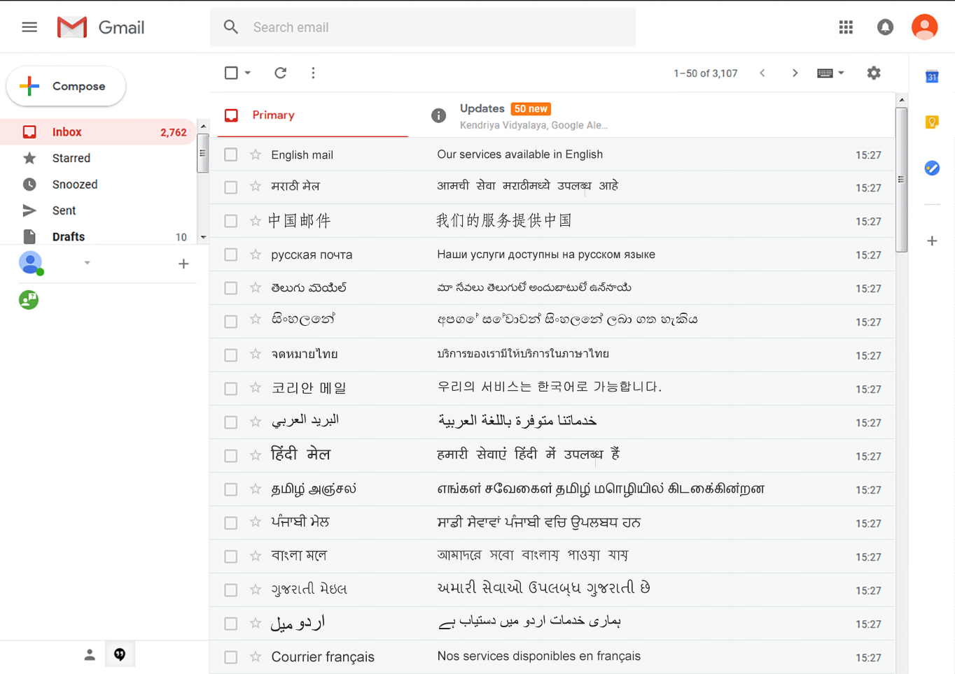
Gmail Supports sending and receiving EAI

Slide 20
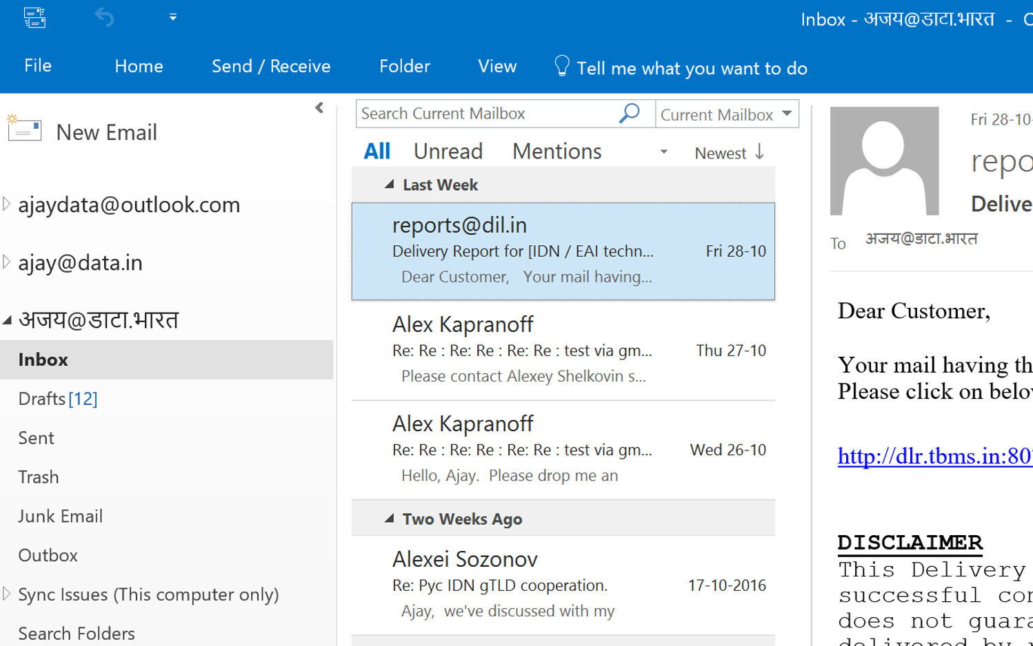
Microsoft Outlook Supports

Slide 21
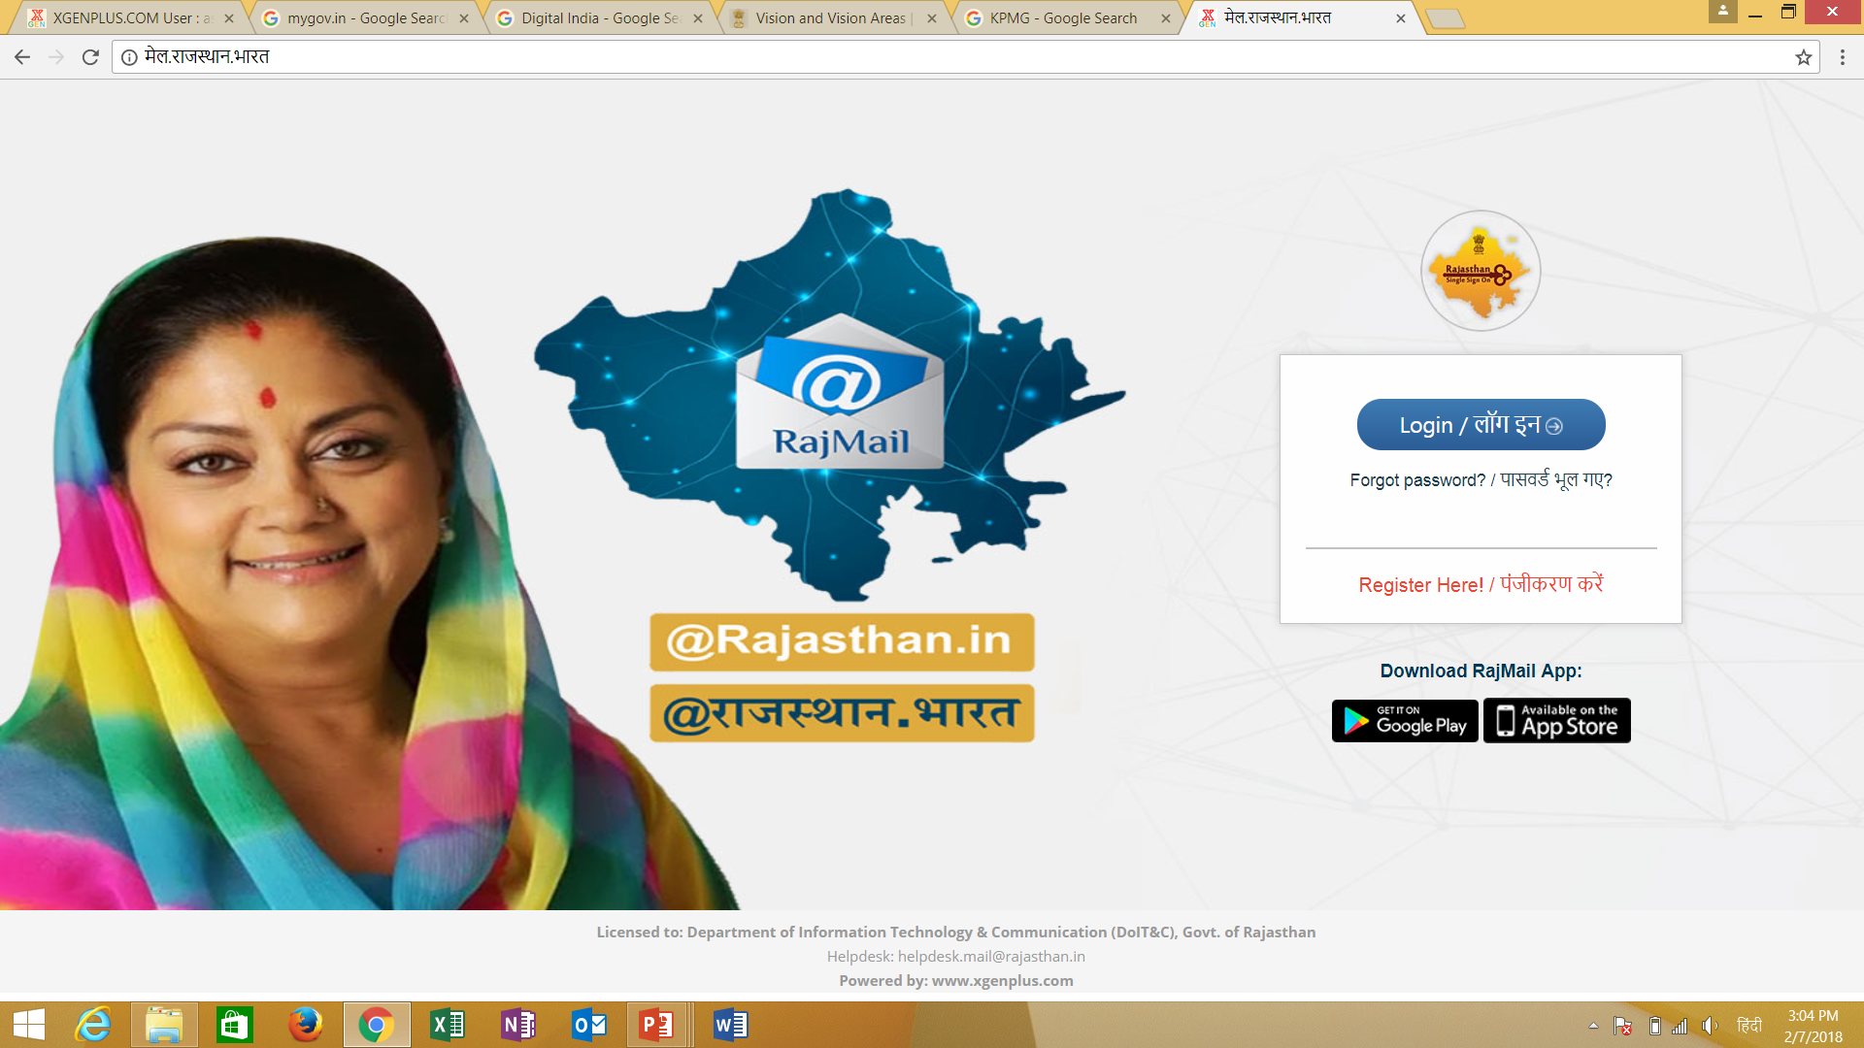
Government of Rajasthan Launched मेल.राजस्थान.भारत

Slide 22
Deployment Experience
Sites upgrade email when their platform vendor issues an upgrade
Few sites enable EAI if it's not default
Even fewer disable EAI if it is the default
Postfix ,Exim and Qmail are ready to support SMTPUTF8
Proprietary Solutions : XgenPlus from India
EAI : आपका_नाम@उदाहरण.भारत -----→ संभव है
Notes:
Motivation slide.
Students should understand what is expected of them with regard to UA and EAI.

Slide 23
Multilingualism on Internet : Current Trends
Facebook supports more than 100 languages (compared with 70 languages last year) and is actively increasing the languages that it supports
Google Translate is available for more than 100 languages, Twitter supports 34 languages.
The world’s most popular apps are also increasing the number of supported languages:
  Whatsapp is available in up to 60 languages (compared with 20 languages last year),
  Instagram in 33 languages.
Notes:
Motivation slide.
Students should understand what is expected of them with regard to UA and EAI.

Slide 24
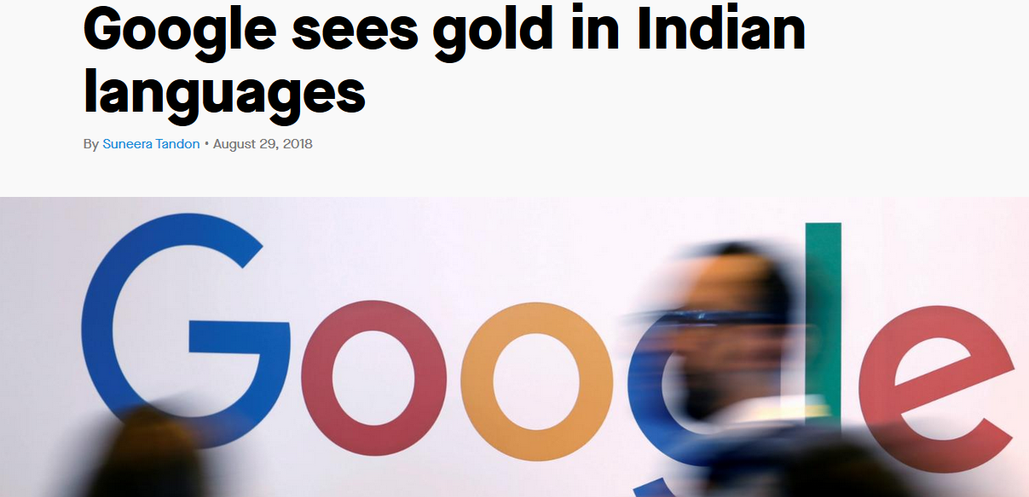
Multilingualism on Internet : Current Trends
Source : qz.com
Notes:
Motivation slide.
Students should understand what is expected of them with regard to UA and EAI.

Slide 25
Multilingualism on Internet : Current Trends
On Aug. 28, Google launched Navlekha, a platform to help Indian language publishers get on the web.
It will use artificial intelligence to render any PDF containing Indian language content into editable text.
This will make it easy for “print publishers to create mobile-friendly web content.
India has 22 official languages, but the content on the internet is predominantly in English.
According to Google’s estimates, 90% of the country’s registered 135,000 publications don’t even have a website. For more users, making regional content available is crucial.
Notes:
Motivation slide.
Students should understand what is expected of them with regard to UA and EAI.

Slide 26
Multilingualism on Internet : Current Trends
Navlekha has already begun onboarding Hindi publishers from Delhi.
Navlekhā also provides Indian-language publishers access to a page domain and free web hosting services, including support for Google’s AdSense advertising program ---→ Monetization
Google has been pushing for vernacular languages in India. In 2016, it launched the tap to translate programme that lets users translate an image or text to their own native language.
On Aug. 28, it also added a new feature to Google Go, its search app, that now lets users listen to web pages in 28 Indian languages
Search queries in Hindi, according to Krishnaswamy (Director— Public Policy at Google india –are growing 400% on year-on-year basis.
source: https://telecom.economictimes.indiatimes.com
Notes:
Motivation slide.
Students should understand what is expected of them with regard to UA and EAI.

Slide 27
Multilingualism on Internet : Current Trends
Google’s personalized news feed within Google Search will also now display stories from Hindi-language sources, in addition to English.
Google Assistant will now also speak Marathi, the native tongue of more than 80 million people in India.
An additional seven Indian languages will be added to Google Assistant “soon,”.
Nine out of ten new internet users in the next four years will use local languages.
By 2021, there'll be over 500 million users of Indian languages while English users will be less than half the number.
source: https://venturebeat.com and https://www.forbes.com
Notes:
Motivation slide.
Students should understand what is expected of them with regard to UA and EAI.

Slide 28
Multilingualism on Internet : Current Trends
By 2021, Hindi-speaking users alone will overtake English-speaking users and Hindi will be the most used language on the Internet in India.
Marathi, Bengali, Tamil and Telugu speaking internet users will form 30% of the total Indian language internet user base.
Indus OS Labs, a homegrown startup’s Indus OS, based on Android, is a multilingual operating system that supports 12 regional Indian languages.
It also provides built-in features like translation, transliteration, as well as text-to-speech.
Several domestic players like Micromax, Intex and Karbonn have a portfolio of budget smartphones powered by Indus OS
Notes:
Motivation slide.
Students should understand what is expected of them with regard to UA and EAI.

Slide 29
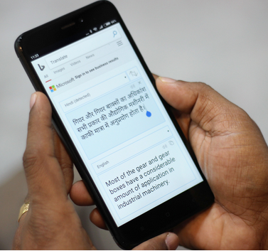
Multilingualism on Internet : Current Trends
Microsoft is also leveraging the power of artificial intelligence and deep neural networks to improve real-time language translation from English to Hindi, Bengali and Tamil and vice versa
Source : https://blogs.msdn.microsoft.com
Notes:
Motivation slide.
Students should understand what is expected of them with regard to UA and EAI.

Slide 30

Multilingualism on Internet : Current Trends
One of the unresolved challenges is the e-commerce ecosystem and the payments interface which are still not Indian-language-friendly, preventing the masses to transact online. Source : https://www.forbes.com
Notes:
Motivation slide.
Students should understand what is expected of them with regard to UA and EAI.

Slide 31
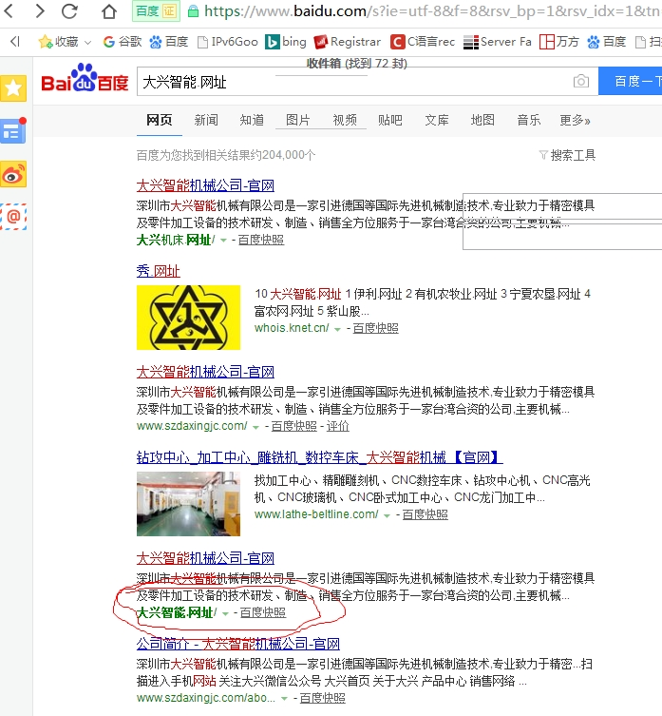
baidu.com (China major search engine) improves the support to IDN.
If you input "大兴智能.网址 " Chinese Domain Names into baidu.com, you get IDN displayed in result page.

Slide 32
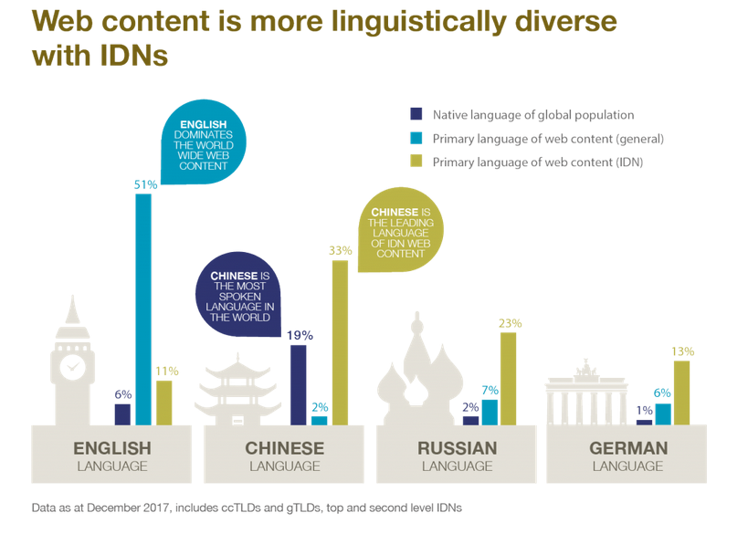
Notes:
Motivation slide.
Students should understand what is expected of them with regard to UA and EAI.

Slide 33
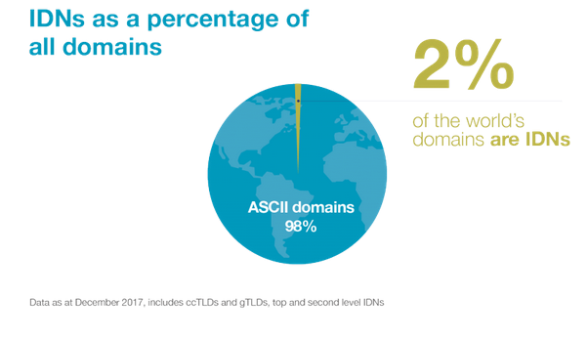
Notes:
Motivation slide.
Students should understand what is expected of them with regard to UA and EAI.

Slide 34
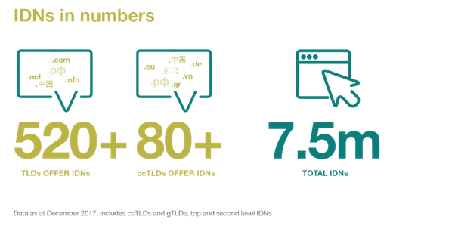
Notes:
Motivation slide.
Students should understand what is expected of them with regard to UA and EAI.

Slide 35
Tools & Resources for Developers
Authoritative Tables:
  http://www.internic.net/domain/root.zone
  http://www.dns.icann.org/services/authoritative-dns/index.html
  http://data.iana.org/TLD/tlds-alpha-by-domain.txt
  See also SAC070: https://tinyurl.com/sac070
Internationalized Domain Names for Applications:
  Tables: https://tools.ietf.org/html/rfc5892
  Rationale: https://tools.ietf.org/html/rfc5894
  Protocol: https://tools.ietf.org/html/rfc5891
Unicode:
  Security Considerations: http://unicode.org/reports/tr36/
  IDNA Compatibility Processing: http://unicode.org/reports/tr46/
Universal Acceptance Steering Group info & recent developments: www.uasg.tech

Slide 36
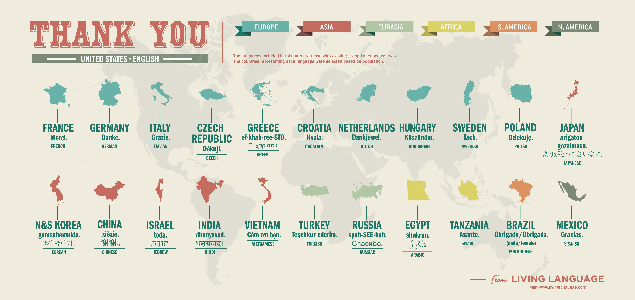
Universal Acceptance Steering Group info & recent developments: www.uasg.tech

Slide 37
Glossary, partial
A-label - The ASCII-compatible encoded (ACE) representation of an internationalized domain name, e.g. how it is transmitted internally within the DNS protocol. A-labels always commence with the prefix “xn--”.
ACE prefix -ASCII Compatible Encoding Prefix.
ASCII Characters - American Standard Code for Information Interchange. These are characters from the basic Latin alphabet together with the European-Arabic digits. These are also included in the broader range of "Unicode characters" that provides the basis for IDNs.
API - An Application Programming Interface (API) is a set of routines, protocols, and tools for building software and applications. An API may be for a web based system, operating system, or database system, and it provides facilities to develop applications for that system using a given programming language.
Codespace - Range that define the lower and upper bounds for an encoding.
Code Points - A code point or code position is any of the numerical values that make up the code space. They are used to distinguish both, the number from an encoding as a sequence of bits, and the abstract character from a particular graphical representation (glyph).
DNS Root Zone - The root zone is the central directory for the DNS, which is a key component in translating readable host names into numeric IP addresses.

Slide 38
Glossary, partial
EAI - Email Address Internationalization is an email address that requires the use of Unicode in all parts of the email address.
IANA - Internet Assigned Numbers Authority. Its functions include: (1) Maintenance of the registry of technical Internet protocol parameters, (2) Administration of certain responsibilities associated with Internet DNS root zone, and (3) Allocation of Internet numbering resources.
ICANN - The Internet Corporation for Assigned Names and Numbers (ICANN) is an internationally organized, non-profit corporation that has responsibility for Internet Protocol (IP) address space allocation, protocol identifier assignment, generic (gTLD) and country code (ccTLD) Top-Level Domain name system management, and root server system management functions.
IDN - Internationalized Domain Names. IDNs are domain names that include characters used in the local representation of languages that are not written with the twenty-six letters of the basic Latin alphabet “a-z”, the numbers 0-9, and the hyphen “-“.
IDNA - Internationalized Domain Names in Applications.
IDN ccTLD - Country Code Top-level Domain that includes characters used in the local representation of languages that are nor written with the twenty-six letters of the basic Latin alphabet “a-z”. Examples: .рф (Russia), صر . Egypt, and السعودية . Saudi Arabia.

Slide 39
Glossary, partial
IETF - The Internet Engineering Task Force (IETF) is a large open international community of network designers, operators, vendors, and researchers concerned with the evolution of the Internet architecture and the smooth operation of the Internet. It is open to any interested individual. The IETF develops Internet Standards and in particular the standards related to the Internet Protocol Suite (TCP/IP).
Language - The method of human communication, either spoken or written, consisting of the use of words in a structured and conventional way.
Punycode - It is an algorithm to represent Unicode with the limited character subset of ASCII supported by the Domain Name System. Punycode is intended for the encoding of labels in the Internationalized Domain Names in Applications (IDNA) framework.
Registrar - An organization where domain names are registered by users. The registrar keeps records of the contact information and submits the technical information to a central directory known as the “registry”.
Registry - The authoritative, master database of all domain names registered in each Top Level Domain.
RFC - A Request for Comments (RFC) is a formal document from the Internet Engineering Task Force (IETF) that is the result of committee drafting and subsequent review by interested parties.

Slide 40
Glossary, partial
Script - The collection of letters or characters used in writing, representing the sounds of a language.
Second-level domain name - In the Domain Name System (DNS) hierarchy, a second-level domain (SLD or 2LD) is a domain that is directly below a top-level domain (TLD). For example, in example.com, example is the second-level domain of the .com TLD.
U-label - A "U-label" is an IDNA-valid string of Unicode characters including at least one non-ASCII character. Conversions between U-labels and A-labels are performed according to the Punycode specification [RFC 3492].
UA-ready Software or UA-Readiness - Universal Acceptance Ready Software. It is a software that has the ability to Accept, Store, Process, Validate and Display all Top Level Domains equally and all IDNs, hyperlink and email addresses equally.
Unicode - A universal character encoding standard. It defines the way individual characters are represented in text files, web pages, and other types of documents. Unicode was designed to support characters from all languages around the world.

Slide 41
Some Relevant RFCs to Universal Acceptance
Internationalized Domain Name Acceptance
Internationalized Domain Names for Applications (IDNA): Definitions and Document Framework | https://tools.ietf.org/html/rfc5890
Internationalized Domain Names in Applications (IDNA): Protocol | https://tools.ietf.org/html/rfc5891
The Unicode Code Points and Internationalized Domain Names for Applications (IDNA) | https://tools.ietf.org/html/rfc5892
Internationalized Domain Names for Applications (IDNA): Background, Explanation, and Rationale | https://tools.ietf.org/html/rfc5894
Notes:
additional available at https://uasg.tech/wp-content/uploads/2017/06/UA006-Relevant-RFCs.pdf

Slide 42
Additional RFCs to Referenced
Punycode: A Bootstring encoding of Unicode for Internationalized Domain Names in Applications (IDNA) | https://tools.ietf.org/html/rfc3492
UTF-7: A Mail-Safe Transformation Format of Unicode | https://tools.ietf.org/html/rfc2152
Additional RFC relevant to Universal Acceptance:
https://uasg.tech/wp-content/uploads/2017/06/UA006-Relevant-RFCs.pdf

