Slide 1
Cybersecurity and Governance
inSIG 2017 – Trivandrum, Kerala, India
Asha Hemrajani
Member of the Board of Directors, ICANN
25 October 2017

Slide 2
Agenda
The Cyber Threat Landscape Today
ICANN and its Role
DNSSEC
Internet of Things (IoT)
KSK Rollover
Extension of Multistakeholder Model

Slide 3
The Cyber Threat Landscape

Slide 4
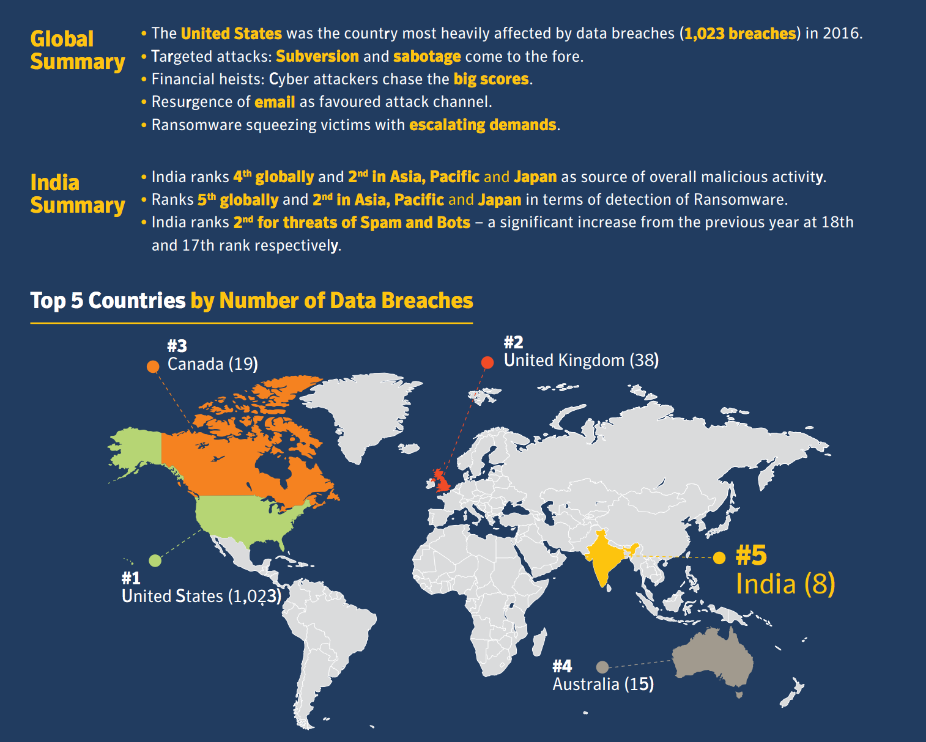
Global Cyber Threat Landscape (Symantec, 2017)
Cybersecurity attacks vary by type
Threat landscape varies by region
Most attacked country is the US
India:
4th globally as source of overall malicious activity
5th globally in detection of ransomware
2nd for spams & bots
5th globally in terms of data breaches

Slide 5
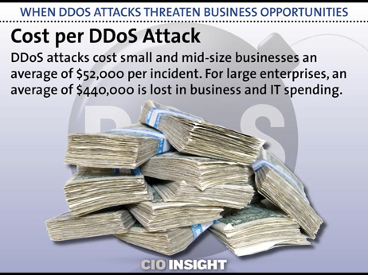
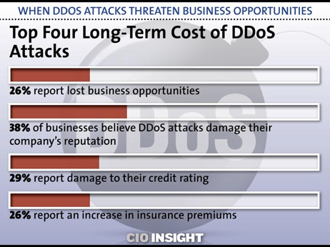
Security Online
Cybersecurity is high on everyone’s agenda
Billions lost annually due to cybersecurity attacks of various types

Slide 6
ICANN and its Role

Slide 7
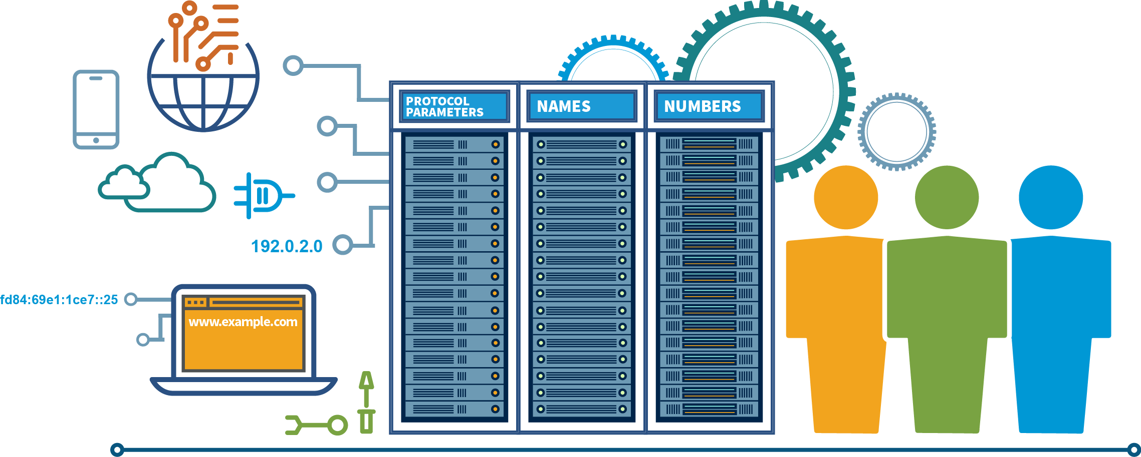
What does ICANN do?
Coordinating with our partners,
we help make the Internet work.
Notes:
Suggested Talking Points:
The Internet is administered by a loose, decentralized and distributed collection of organizations and people who set rules, standards and policies, and provide technical support so that the world can be connected on one global, secure and stable Internet.
ICANN is one part of the larger Internet governance ecosystem.

Slide 8
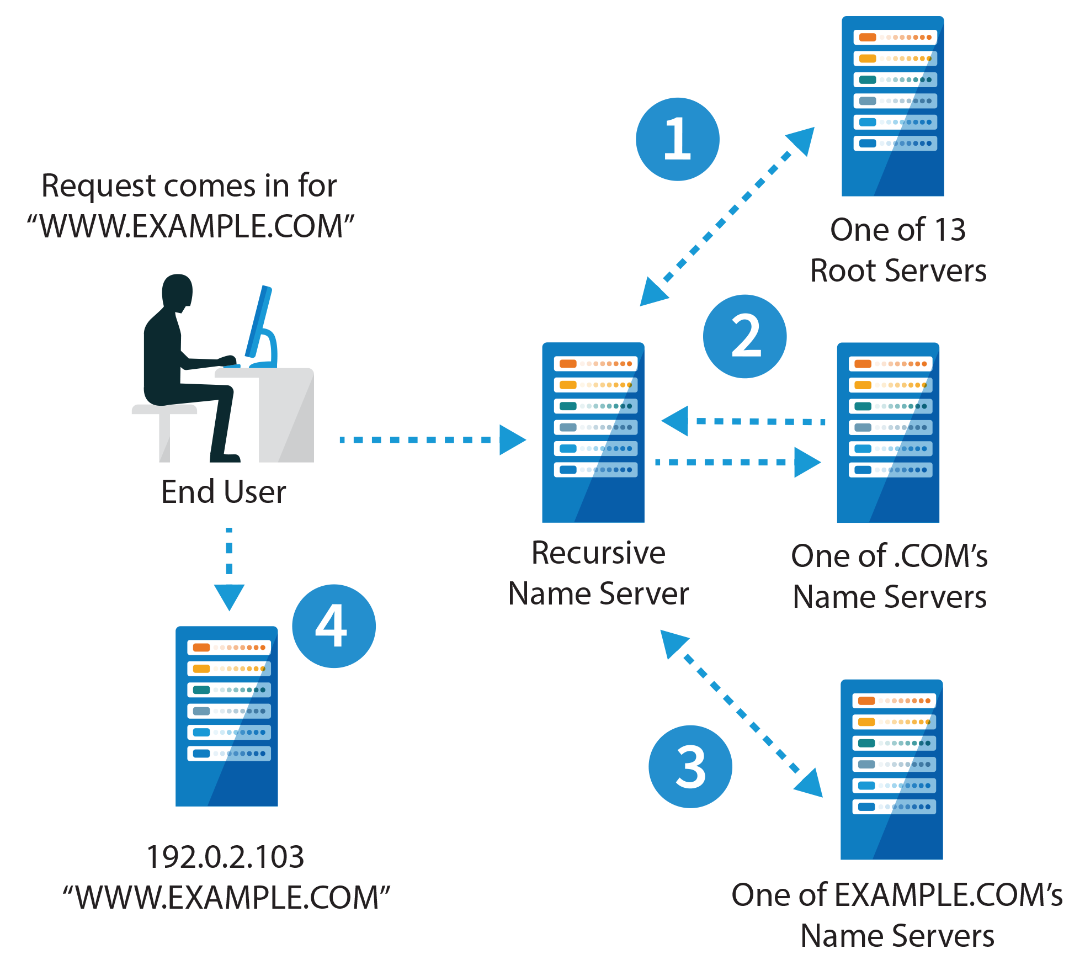
How DNS Works
Notes:
When you sit down at your browser and type www.icann.org, your browser sends a DNS request off to a server, typically run by your Internet Service Provider, known as a resolver.
act as your agent
happens within tens of milliseconds, billions of times a day with no issue, and all the valid answers are cached so the number of times your resolver must go through this exercise is minimized.
Unfortunately, the original DNS protocol had a bug that allows bad guys to insert wrong answers in this chain of lookups or the cache, allowing man-in-the-middle attacks that can redirect browser sessions to attacker-controlled machines or cause other havoc.
Think of it as driving on an isolated highway toward a remote branch of your bank and a bad guy changes the street signs guiding you, directing you to a building that looks like your bank but is actually run by the bad guys.

Slide 9
The Bad
Cache Poisoning Attacks
  Vulnerable resolvers add malicious data to local caches
DNS Hijacking
  A man in the middle (MITM) or spoofing attack forwards DNS queries to a name server that returns forged responses
  e.g. DNSChanger (One of the biggest cybercriminal takedown in history)
Notes:
What are some of the bad things that can happen?
DNS servers are used in an organization's network to improve resolution response performance by caching previously obtained query results.
To perform a cache poisoning attack, the attacker exploits flaws in the DNS software. the server ends up caching the incorrect entries locally and serve them to other users that make the same request.
This attack can be used to redirect users from a website to another site of the attacker's choosing. Users could end up downloading malware or This technique can also be used for phishing attacks, where a fake version of a genuine website is created to gather personal details such as bank and credit/debit card details.

Slide 10
DNSSEC

Slide 11
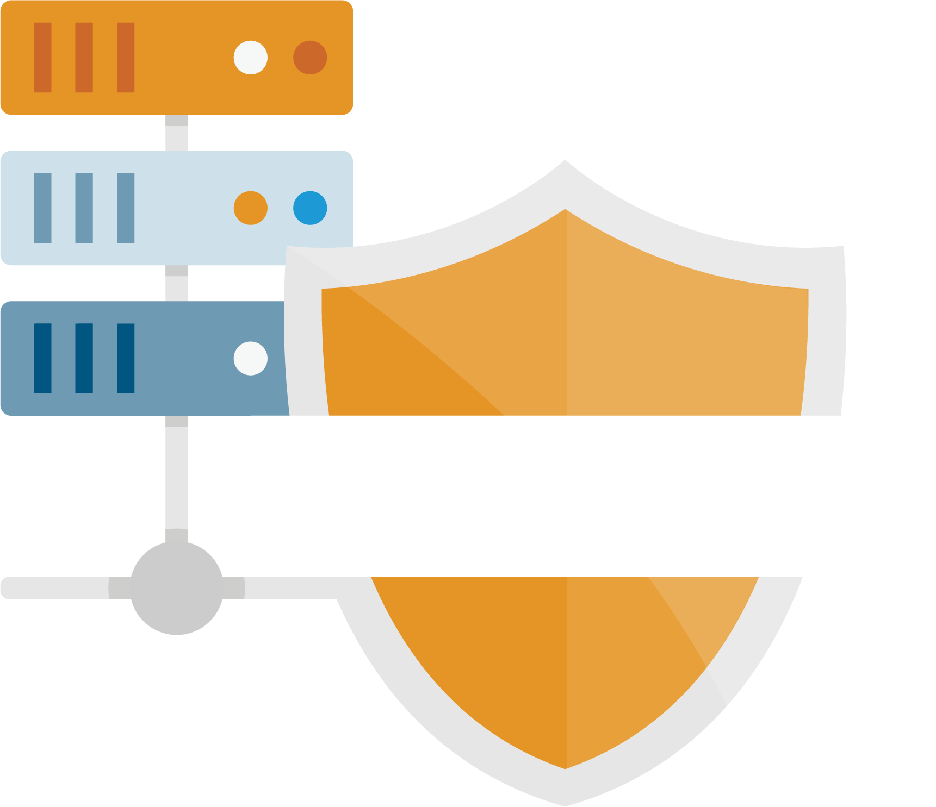

What is DNSSEC?
DNSSEC = “DNS Security Extensions”
DNSSEC is a protocol that is currently being deployed to secure the Domain Name System (DNS)
DNSSEC adds security to the DNS by incorporating public key cryptography into the DNS hierarchy, resulting in a single, open, global Public Key Infrastructure (PKI) for domain names
Result of over a decade of community based, open standards development
Notes:
Solution: DNSSEC

Slide 12
What is DNSSEC?
“DNS SECurity enhancements” (DNSSEC) improves the DNS by digitally signing DNS data. This provides:
  Data origin authentication
    “I looked up DNS data and I verify which zone the data came from”
  Data integrity
    “I know the data in the zone hasn’t been modified since it was signed”
  Proof of non-existence
    “I can be sure the data I’m looking for is not in the zone”
A public/private key pair is created for each zone (e.g., EXAMPLE.COM).
  The private key is kept secret
  The public key in published in the DNS
Zone data is signed with the zone’s private key to produce digital signatures
  After a resolver (DNS client) looks up data in a signed zone, that data can be validated with the zone’s public key
Notes:
This slide can be used for text, graphics or any other elements.

Slide 13
Chain of Trust
Q: If a zone publishes its public key, how can you trust it?
  A: The parent zone uses its private key to sign the child zone’s public key.
This process goes all the way to the DNS root zone. Example:
  WWW.EXAMPLE.COM is signed with EXAMPLE.COM’s private key
  EXAMPLE.COM’s public key signed with COM’s private key
  COM’s public key signed by the root’s private key
  The root’s public key is not signed by anyone: we need to just trust it
    The root zone’s public key is called the root trust anchor
To validate WWW.EXAMPLE.COM’s DNS data, we build a chain of trust from EXAMPLE.COM’s public key to COM’s public key to the root’s public key.
  And the root’s public key is distributed with every validating resolver.
Root Trust Anchor
The Root
COM
EXAMPLE.COM
www.example.com

Slide 14
How Does DNSSEC Work?
Without DNSSEC
With DNSSEC
majorbank.com
= IP address A
DNS
majorbank.com
= IP address A
DNS
majorbank.com
= Attacker IP address X
majorbank.com
= Attacker IP address X
DNS
DNS
majorbank.com
majorbank.com
IP address X
IP address A
majorbank.com
Passwords
webserver
Passwords
majorbank.com
Desired page
webserver
Attacker’s
Attacker’s page
webserver

Slide 15
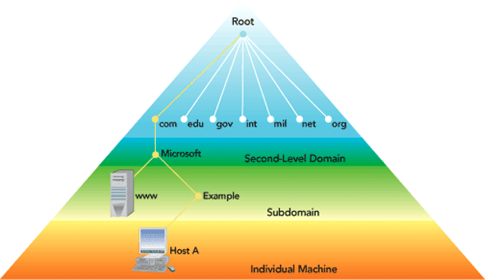
Domain Name System (DNS)
TLDs
gTLDs
ccTLDs IDNs
Notes:
There are now over 1500 top-level domains, everything from .AAA to .ZW, stored in what is known as the root zone
protected by a protocol known as the DNS Security Extensions or DNSSEC
going to be changing the key used by DNSSEC to protect the root zone.
This is kind of a big deal.
we promised the global Internet community that we’d change the key after 5 years
we’ll be spending about two years to very slowly and carefully update the root zone’s key
nightmare scenario

Slide 16
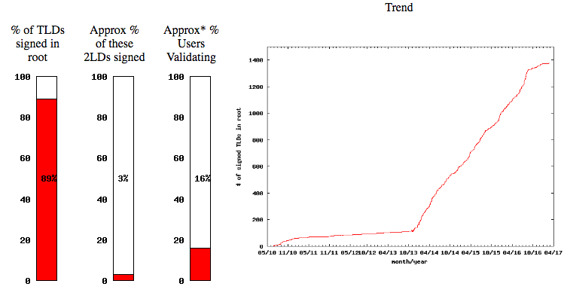
DNSSEC Deployment

Slide 17
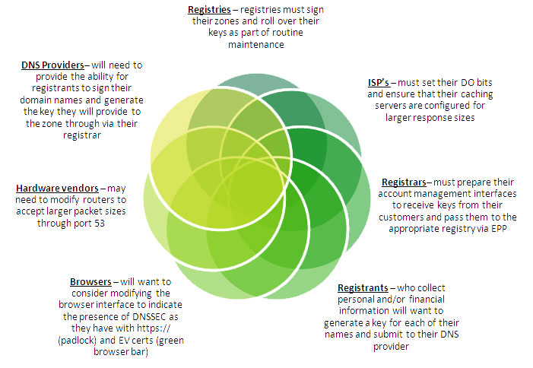
Who Should Deploy DNSSEC?
Source - https://www.neustar.biz/

Slide 18
Internet of Things

Slide 19
What is the Internet of Things?
IoT (Internet of Things) is about connecting
the next wave of devices to the Internet.
  A universe of devices that may be present in
  all aspects of lifestyle, health, or society
  These devices are locally and globally connected via Internet services

Slide 20
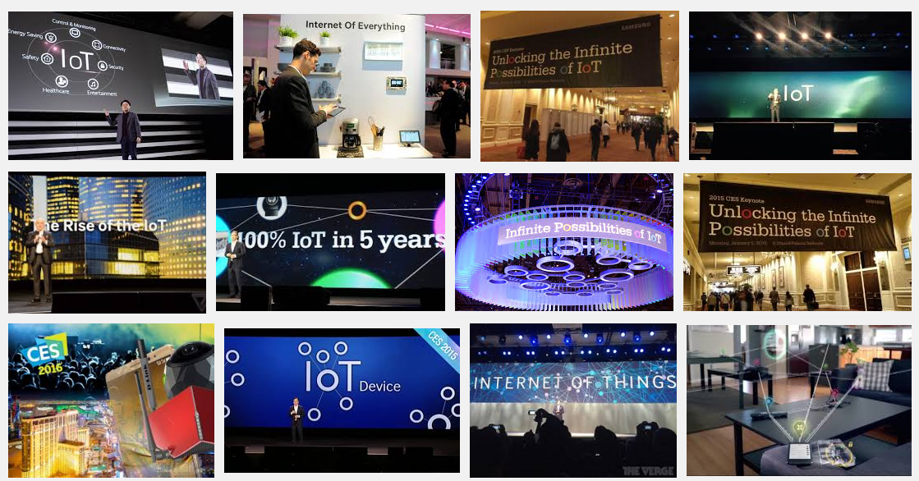
The Rise and Rise of IoT

Slide 21
Threat Landscape in IoT
IoT devices may increasingly control traditionally human-directed activities at much larger scales than ever before
  Autonomous vehicles
  Aviation
  Package or other forms of delivery
  Residential or business environmental control systems
Devices may increasingly become “part of us”
  They may assist with human bio-functions
  They may store significant or critical health data
There may be no human to detect or respond to malfunction

Slide 22
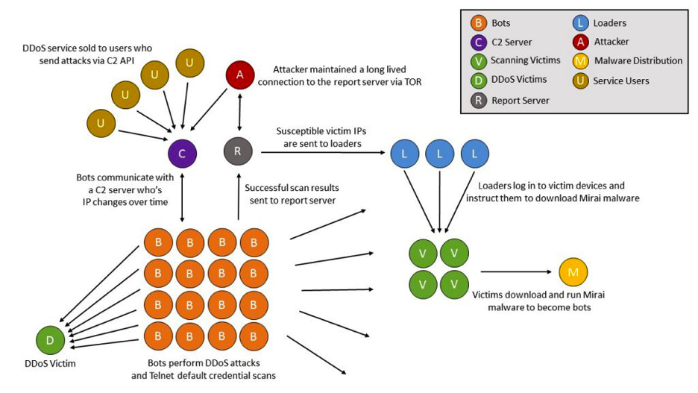
Some threats have already been realized…
“Vulnerable IoT devices are subsumed into the Mirai botnet by continuous, automated scanning for and exploitation of well-known, hardcoded administrative credentials present in the relevant IoT devices. These vulnerable embedded systems are typically listening for inbound telnet access on TCP/23 and TCP/2323.”
Roland Dobbins, Arbor Networks
http://blog.level3.com/security/grinch-stole-iot/
https://www.arbornetworks.com/blog/asert/mirai-iot-botnet-description-ddos-attack-mitigation/

Slide 23
Once you build them…
How do you continue to secure them?
History shows that commodity devices
  Are not routinely upgraded or patched
  Are not always managed according to best practices
Commodity devices also are saddled with the “shelf life” problem
Units may occupy shelves in stores for months or years
Multiple versions of firmware or software may be in the field
Vendors may not offer consumer manageable upgrade methods

Slide 24
Retail cost objectives conflict with security objectives
Secure or confidential communication protocols may be incompatible with memory or CPU footprint. This affects
  Cost of device
  Development cost
  Desired time to market window of manufacturers
Persistently strong incentives to collect metadata or personal identifying information
  Cost of implementing authorization (e.g., data permissions)
  Incentives to provide data to third parties for fee
  Is anyone considering data protection on devices?

Slide 25
DNSSEC and IoT
Security is a well known missing piece for IoT
Many IoT applications have physical world safety implications
  human harm, disruption of critical infrastructure service delivery
Can we use an existing infrastructure to enable a secure, global, cross-organizational, trans-national communication channel between devices?
  Specifically, can we use DNSSEC for key distribution necessary to secure channels and then securely bootstrap application specific security mechanisms?
Notes:
Holy grail of true end-2-end security. Makes some nervous. German ISPs have embraced DANE.
This is a recognized issue but businesses are too busy focusing forward.
This will be an issue and is therefore an opportunity for those looking ahead with skills.
BTW: That IoT light bulb is connected to the same home network on which you do your banking transactions…hmmm.

Slide 26

Can DNS Provide a Foundation for Scalable Security?
root
DNS is already present
DNSSEC adds security
com
and crosses organizational boundaries.
google.com
za
co.za
security.co.za
electric.co.za
iotdevices.co.za
water.rickshome.security.co.za
car.rickshome.iotdevices.co.za
aircond.rickshome.electric.co.za
window.rickshome.security.co.za
thermostat.rickshome.iotdevices.co.za
meter.rickshome.electric.co.za
door.rickshome.security.co.za
refrigerator.rickshome.iotdevices.co.za
Animated slide
Notes:
An opportunity to build security into IoT devices from the start.

Slide 27
Root Zone Key-Signing Key (KSK) Rollover

Slide 28
Root Zone KSK
The full name for the root zone’s public key used as a trust anchor is the Root Zone Key-Signing Key (KSK)
The root zone KSK is the most important key in DNSSEC
Any software performing DNSSEC validation must have the Root Zone KSK configured as a trust anchor
KSK
DATA

Slide 29
Root Zone KSK Rollover
To date, there has been one Root Zone KSK
  Created when the root was first signed in 2010
A new KSK will be used
  ICANN is “rolling the Key” or changing the KSK
  Recursive resolvers performing DNSSEC validation need to be updated with the new key
  originally planned starting on 11 October 2017
  Researchers at Verisign & ICANN analyzed root server traffic to determine how many resolvers have been updated with the new KSK
  In September, it was found that 5% of resolvers used by ISPs and network operators still have old root KSK configured. Hence decision to postpone the rollover.
  Continued data collection and consultation with the technical community
  Delay affords additional time for network operators and ISPs to be certain that their systems are ready for rollover.
  A carefully planned, multi-year process to ensure continued smooth operations of the global secured DNS

Slide 30
Extension of MSM Model to Cybersecurity?

Slide 31
Thank You!
Asha Hemrajani
asha.a.hemrajani@gmail.com

