Slide 1
The Internet is for Everyone
India School of Internet Governance Trivandrum, 24 October 2017
Join us to keep the Internet open, thriving and benefitting people around the globe.

Slide 2
Founded in 1992 by pioneers of the early Internet, the Internet Society drives technologies that keep it open and safe. We promote policies that empower people to enable universal access for all.
We stand for a better Internet.
2
Notes:
The Internet Society was founded by some of the Internet's earliest pioneers to help drive the Internet's development around the world. It is also the organizational home of the Internet Engineering Task Force (IETF). Working through a global community of chapters and members bound by a common purpose, the Internet Society coordinates across a broad range of different groups to promote the technologies that keep the Internet safe and secure, advocate for policies that enable universal access and champion an open Internet. The Internet Society believes that an Internet of opportunity should be available to everyone, everywhere and it is the Internet Society's mission to make that vision a reality.

Slide 3
“The Internet Society is operating on a world stage to help all of the stakeholders of the Internet to understand what the implications of the technology are, what policies are beneficial, and what right and freedoms need to be preserved in the use of this system.”
Vint Cerf

Slide 4
Our Story
We are a global movement that champions an open Internet for all. This is an Internet that offers hope, brings opportunity and celebrates humanity.
We break down barriers, drive inclusivity, promote open standards and connect the unconnected.
We are committed to an Internet for everyone everywhere; free from censorship and unnecessary regulation, an enabler of progress.
An Internet that can build a business from a spark of an idea, educate the most remote communities, protect human rights and drive economic and social development.
2

Slide 5
The Internet Society at Work
Provides leadership in policy issues
Promotes Internet technologies that matter
Advocates open Internet standards
Develops Internet infrastructure
Undertakes outreach that changes lives
Recognizes industry leaders
Notes:
The Internet Society:
Encourages open development of standards, protocols, administration.
Enables economic growth in developing countries through education and training
Fosters participation and develops new leaders in areas important to the evolution of the Internet.
Provides reliable information about the Internet.
Leads and facilitates discussion of issues that affect Internet evolution and developments.

Slide 6
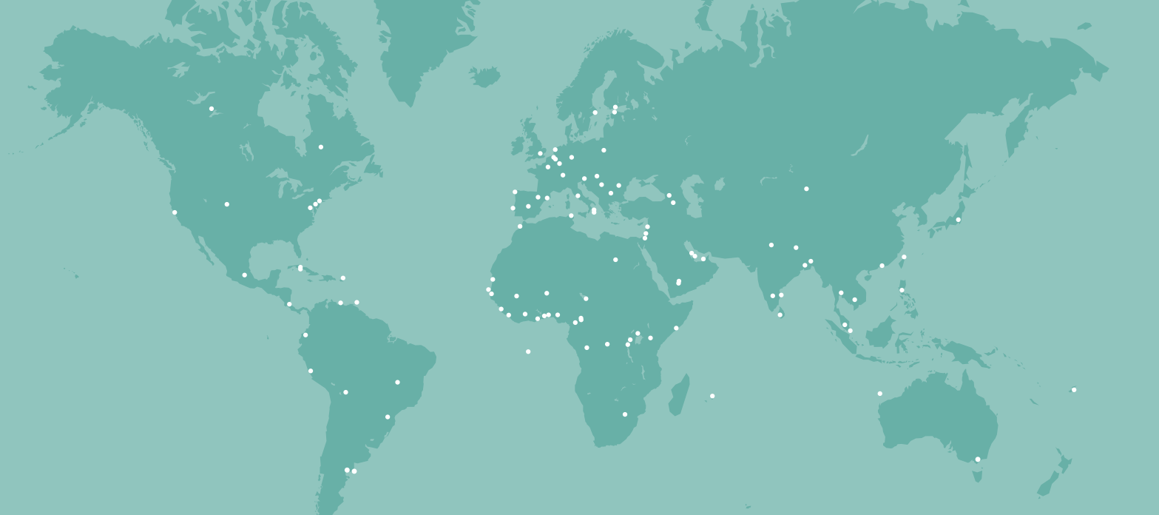
Global Presence
Our global community of members and Chapters span over 230 countries, territories, and areas of geographic interest world-wide.
EUROPE
NORTH AMERICA
MIDDLE EAST
ASIA
AFRICA
LATIN AMERICA/CARIBBEAN

Slide 7
IETF
The Internet Engineering Task Force (IETF) is the premiere Internet standards organization.
The mission of the IETF is to make the Internet work better by producing high quality, relevant technical documents that influence the way people design, use, and manage the Internet.
The Internet Society is the organizational home of the IETF.

Slide 8
Our Members, Chapters and Partners

Slide 9
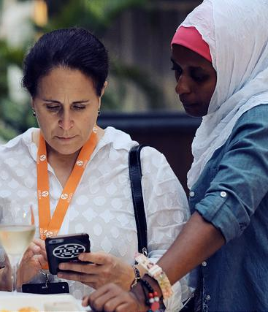
Membership is Vital
© 2016 Nyani Quarmyne / Internet Society CC BY-NC-SA
+103,580 people working for an Internet that brings opportunity, hope and human development
Our members come together from every continent and walk of life to support our mission and the hope of a better future.
Members benefit from:
Open, collaborative discussions
Special events and consultations
Learning and personal development
Information about issues they care about
Networking and interacting with peers
8
Notes:
This is Your Internet…Join It.
Your membership to the Internet Society gives you a powerful voice.
As a grassroots organization, the Internet Society works hand-in-hand with its members to build a world that supports everyone’s right to share knowledge, innovate, and be heard.
[NOTES FOR INDIVIDUAL MEMBERS]
By becoming a member you will:
Have your voice heard in critical policy debates that are shaping the future of an open Internet
Have access to technical training and expertise
Apply for grants and fellowships that could help you make your community, city, or country a better place
Take part in or support projects and education in emerging economies
Get the latest information that will help empower you to protect your online privacy and identity
Become part of a powerful community that is working to make the world better
By working together we believe change is not only possible, it can happen now.
Take Action – Join the Internet Society today!

Slide 10
Chapters Play a Key Role
Chapters address unique local and regional perspectives on emerging Internet issues. We have 129 of them.
Internet Society Chapters form a community that advances our mission to:
Engage members through a common global vision
Offer technical workshops and training
Provide educational and networking events
Inform policy and decision makers
© Internet Society / Panos Pictures / Tommy Trenchard
Notes:
Chapters help the Internet Society addresses the specific needs of Internet users in communities worldwide.
Whether people are connected by geography or a common interest (such as special needs for differently-abled individuals) through activities that promote:
* Capacity building
* Education and training
* Participation in public policy and debates
The influence of Chapters within their communities is deeply felt. The Internet Society provides opportunities and resources to empower Chapter leaders and energize their members and volunteers. These relationships illustrate the highly collaborative nature of the Internet Society’s work, both internationally and on a local level.
International bodies and assemblies driving better laws and policies to help ensure the global health of the Internet.
Local people who are developing the Internet to serve the unique needs of their friends, family, and communities.
Non-governmental organizations help deliver projects on-the-ground or work with us in coordinating efforts around the world.
Technical experts and engineers share ideas and information about cutting-edge advances in the science and applications.
University and academic institutions ensure we continue to support cutting edge research.
Local and global businesses help make sure technology is developed in a way that can be adapted and used by anyone, anywhere.

Slide 11
Chapters In India
6 chapters in India—Delhi, Kolkata, Chennai, Trivandrum, Bangalore, and Mumbai—help advance our mission.
Internet Society’s Indian Chapters have collaborated with each other over time:
Trivandrum, Delhi and Kolkata for InSig
Regional dialogs on Internet policy and standards
Internet issues that matter to India
Capacity building
© Internet Society / Subhashish Panigrahi

Slide 12
Our Partners
The Internet Society cannot achieve its goals alone.
Because the Internet impacts all of us, we work with partners of all shapes and sizes to address the wide range of social, economic, and policy issues. Our partners include:
International bodies and assemblies
Local non-governmental organizations
Technical experts and engineers
University and academic institutions
Local and global businesses
Rural or urban students and teachers
Notes:
The Internet Society works globally, across the broad range of policy, technology, and development, which allows it to bring unique perspectives and insight about how to address some of the significant issues facing the Internet today.

Slide 13
How We Work
Operating at the intersection of policy, technology and development allows the Internet Society to be a thought leader on issues key to the Internet’s continued growth and evolution.

Slide 14
Our Priorities
Restoring trust and connecting the unconnected are key to realizing an Internet of opportunity for everyone.
Trust
Without trust, the Internet cannot deliver its potential benefit to the entire world. Users must view the Internet as a safe and reliable means to communicate, and be willing to use online services for commerce, government, and social interaction.
Access
We believe Internet access is a key enabler for economic, social, and human development. But only half the world is connected and the rate of Internet access growth is decreasing. Issues such as trust in the Internet have joined cost and availability as barriers to access.

Slide 15
Policy
The Internet Society champions public policies that enable open access.
We operate collaboratively and inclusively with governments, national and international organizations, civil society, private sectors, and other parties to reach decisions about the Internet that conform with our core values.
We work in a multi-stakeholder fashion towards the development of an open and sustainable Internet for the benefit of all people.
Because the Internet impacts all of us, we work with partners around the globe to make sure we can address a wide range of social, economic, and policy issues that interfere with an open and sustainable Internet.

Slide 16
Events and Opportunities
The Internet Society is at the heart of the Internet community and active in conferences and events around the world.
InterCommunity uses the power of the Internet to bring together our global membership to discuss the issues we care about.
INETs bring together users, policy makers, technologists, and operators in a cooperative event focusing on development and relevant local and global issues.
Network and Distributed System Security Symposium (NDSS) encourages information sharing among members of the Internet community who design, develop, exploit and deploy new and emerging technologies that define network and distributed system security.

Slide 17
Grants and Awards
The Internet Society provides grants and awards to initiatives and outreach efforts that address the humanitarian, educational, and societal contexts of online connectivity.

Slide 18
Grants
Beyond the Net Funding Programme gives Internet Society members the opportunity to contribute at a local or regional level.
ICT Innovation Programmes are designed to promote the development of innovative approaches to Internet and communications challenges in developing countries.
Individual Fellowships blend coursework, practical experience and mentorship to help prepare young professionals to become the next generation of Internet technology, policy, and business leaders.
More: https://www.internetsociety.org/grants-and-awards

Slide 19
Awards
The Jonathan B. Postel Service Award is presented each year to an individual or organization that has made outstanding contributions in service to the data communications community.
Applied Networking Research Prize (ANRP) is awarded for recent results in applied networking research that directly improves products and services, and advances related Internet standards.
Internet Hall of Fame celebrates the individuals whose extraordinary contributions have made the Internet, its worldwide availability and use, and its transformative nature possible.
Postel award recipient Mahabir Pun , Founder , Nepal Wireless Networking Project
`18

Slide 20
Our Work in Asia-Pacific
Over the past few years, we have built and strengthen our relationships and engagements in Asia-Pacific. The region is a priority for us and holds great opportunities as well as important challenges.

Slide 21
Areas of impact: Digital Divide
“[There] is a broadening gap between the golden billion and and the rest of the humankind in terms of access to and benefits from all the pluses of the ICT and the Internet Development.”
- Technologist, Asia
Asia, Africa and Latin America are three of the regions where access to the Internet is a huge challenge
Most countries rely on the mobile internet
IoT and other new technologies require access to bandwidth and investments in infrastructure
Connie Ma / CC-BY-SA 2.0
`18

Slide 22
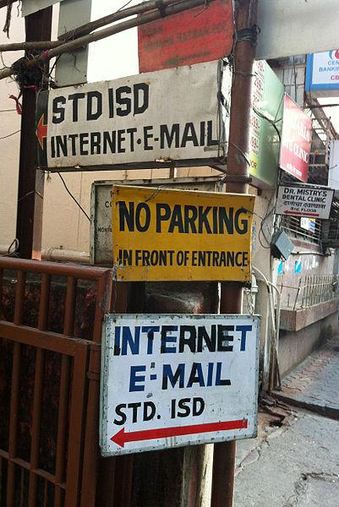
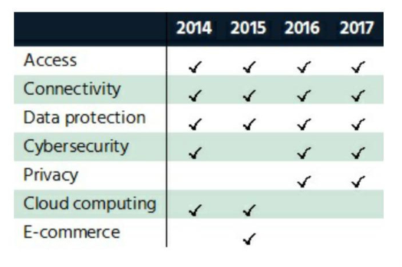
Survey: Policy issues in Asia-Pacific
Which issues made it to the top 5 and for how many years
http://bit.ly/2yKnjXi
Victorgrigas / CC-BY-SA 3.0
`18

Slide 23
Some the Regional Reads

Slide 24
Regional Policy Survey
https://www.internetsociety.org/doc/APACSurvey
Regional Issue Papers
https://www.internetsociety.org/doc/issue-paper-asia-pacific-bureau-–-digital-accessibility
https://www.internetsociety.org/doc/issue-paper-asia-pacific-bureau-–-online-privacy
https://www.internetsociety.org/doc/mapping-online-child-safety-asia-pacific
https://www.internetsociety.org/doc/issue-paper-asia-pacific-bureau-–-gender
https://www.internetsociety.org/doc/issue-paper-asia-pacific-bureau-–-policies-and-regulations-digital-economy-and-society
Regional Issue Papers
Paths to our digital future: http://bit.ly/2y0uADE
Timeline & History of the Internet in Asia and the Pacific: http://bit.ly/2gyzvjP
`18

Slide 25
Internet Governance
Why the Multi-stakeholder Approach Works
Notes:
Introduction
There is no one multistakeholder model. It is a way of doing things.
The multistakeholder approach is a set of tools or practices that all share one basis: ‘Individuals and organizations from different realms participating alongside each other to share ideas or develop consensus policy’.
The multistakeholder approach brings stakeholders together to solve common problems or to achieve goals.
It favors cooperation and collaboration, because we get better answers to questions when many voices can take part in the discussion.
Multistakeholder decision-making is accountable, sustainable, and effective.
The better the inputs and the more inclusive the process, the better the outputs and their implementation.

Slide 26
Internet policy goals must…
maintain the security, stability, and resiliency of the Internet,
support global interoperability and an open and collaborative architecture,
sustain permission-less innovation and widening access, and
allow the Internet to flourish as a dynamic yet reliable platform for limitless opportunity and innovation around the world.
Notes:
Shared goals and methods:
The Internet is open, distributed, interconnected, and transnational.
The key Internet principles which make the Internet a global platform for innovation and economic growth are: participatory bottom-up processes, prioritizing the stability and integrity of systems, and maintaining the open nature of the underlying technologies.
The Internet’s multistakeholder approach has come to be accepted as the optimal way to make policy decisions for a globally distributed network.
In this governance framework, issues must be addressed by all relevant stakeholders in a spirit of collaboration and shared responsibility.
The harder and more interconnected the problem, the more multistakeholder the path to the solution needs to be.
Experience has shown that shared goals are important to success, and focused goals help build consensus.
Respect each other’s perspectives and time, and build on existing structures and relationships.

Slide 27
The multi-stakeholder approach is useful…
when decisions impact a wide and distributed range of people and interests,
where there are overlapping rights and responsibilities across sectors and borders,
if different forms of expertise are needed, such as technical expertise, and/or
where legitimacy and acceptance of decisions directly impacts the implementation.
Notes:
When is the multistakeholder approach useful?
The multistakeholder approach is useful, robust, and adapable:
when decisions impact a wide and distributed range of people and interests,
where there are overlapping rights and responsibilities across sectors and borders,
if different forms of expertise are needed, such as technical expertise, and/or
where legitimacy and acceptance of decisions directly impacts the implementation.

Slide 28
The Internet’s Governance Landscape
ICANN
RIRs
IANA
gTLDs
ccTLDs
Governments
Governmental Regional Organizations
Multilateral Institutions
Internet Society
Other Policy Discussion Forums
Other Standards Bodies
W3C .
ITU-T .
Specialized Bodies .
Internet Society Affiliated Organizations
IETF .
IAB .
IRTF .
Naming and Addressing
Local, National, Regional, and Global Policy Development
Open Standards Development
Chapters
Individual Members
Organization Members
INTERNET
ECOSYSTEM
Governments
Internet Society Chapters
Individual Members
Organization Members
Multilateral Institutions Development Agencies
Internet Community Organizations and Businesses
Universities and Academic Institutions
Shared Global Services and Operations
Education and Capacity Building
Root Servers
Network Operators
Service Creators/Vendors
Internet Exchange Points
gTLDs
ccTLDs
Users
Individuals
Businesses
Governments
Organizations
Machines/Devices
Service Creators and Equipment Builders
Notes:
The Internet’s governance landscape
This diagram shows the organizations and communities that have organically evolved to guide the operation and development of the technologies and infrastructure that comprise the global Internet.
These organizations share common values and a shared commitment to the open development of the Internet.
The multistakeholder model is a logical consequence of the Internet’s original design.
The Internet’s protocols and standards have been developed openly and transparently with everyone who wants to participate.
Stakeholders bring their expertise and enthusiasm and work collaboratively to deliver better outputs that can be implemented.
These stakeholders include the public and private sectors, academia, and civil society.
Because decision-making is consensus-driven, standards are voluntarily adopted.
The Internet’s multistakeholder approach drives innovation and economic stimulation. It contributes to the evolution of the Internet.

Slide 29
We get better answers to global questions when a range of experts and interests can meaningfully take part in the discussion.
The Internet Society has identified four attributes of successful multistakeholder decision-making:
1
2
3
4
Inclusiveness
and transparency
Collective responsibility
Effective decision-making and implementation
Collaboration through distributed and interoperable governance
Notes:
Attributes of successful multistakeholder decision-making
The work of the global Internet community spans across the years and across the various policy and technical issues that the Internet has faced and will continue to face. We have learned a lot about working effectively with and alongside a variety of legal and regulatory regimes.
All this work has allowed certain attributes to emerge; they may be applied to existing multistakeholder processes to keep them evolving to effectively serve the global public good. They can also be applied to a range of governmental and multilateral processes and institutions where they will help make decision-making more collaborative and effective, and produce workable outcomes that all stakeholders can implement:
1) Inclusiveness and transparency
Those significantly affected by a decision should have the chance to be involved in making it.
The less inclusive a process is, the less likely it is to gain the trust and support of those outside the process.
2) Collective responsibility
We must all share a sense of ownership for realising the benefits that the Internet can bring.
3) Effective decision-making and implementation
Decisions should be made based on open and deliberative processes that consider a wide range of sources and perspectives.
Stakeholders who have been a part of the process tend to work harder to make its implementation a success.
4) Collaboration through distributed and interoperable governance
The Internet is a group effort, with different actors teaming up and working together.
The organizations that coordinate the Internet collaborate where appropriate and otherwise focus on doing their best at their respective jobs.
We must recognize this autonomy and keep dialogue and mutual participation to areas of overlap.

Slide 30
Subhashish Panigrahi
Chapter Development Manager, Asia-Pacific
panigrahi@isoc.org

Slide 31
Panelists
Amrita. | Srinivasan R. | Anupam Agarwal | Prateek Pathak | Ziyam Abdeen
Delhi . Trivandrum . Kolkata . Mumbai . Sri Lanka

